Slide 1
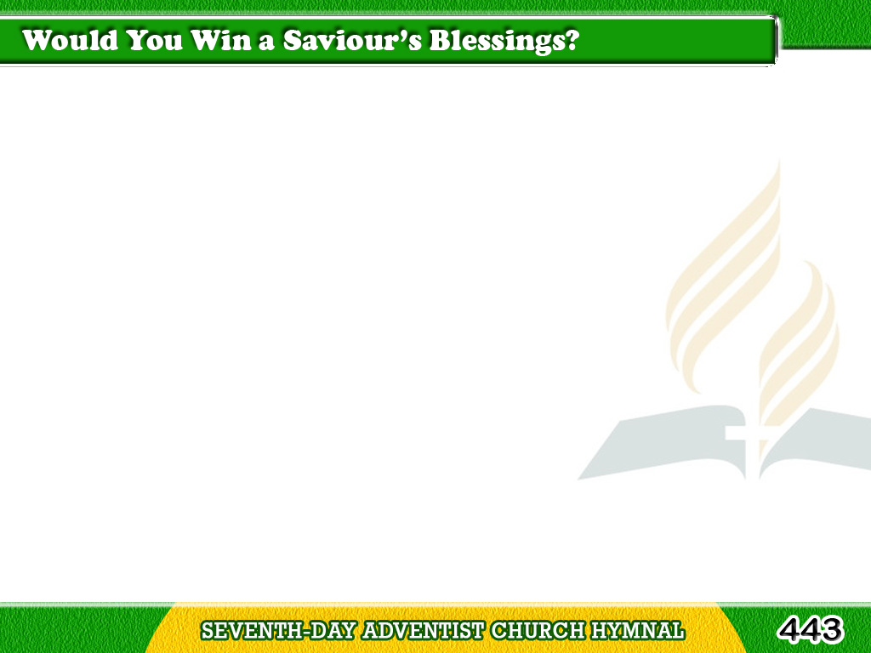
1/3
Would you win
a Saviour’s blessing?
Freely, freely give;
Tagalog
Version

Slide 2
1/3
Would you see
His work progressing?
Freely, freely give;
Tagalog
Version

Slide 3
1/3
Let your souls with love expand,
Open wide a liberal hand;
Would you follow
God’s command?
Freely, freely give.
Tagalog
Version

Slide 4
2/3
With a cheerful heart and willing,
Freely, freely give;
Like the dew its balm distilling,
Freely, freely give;
Tagalog
Version

Slide 5
2/3
Have you little? Give your mite;
O how precious in His sight!
He your offering will requite;
Freely, freely give.
Tagalog
Version

Slide 6
3/3
Give to spread
the grand old story,
Freely, freely give;
Give to speed the light of glory,
Freely, freely give;
Tagalog
Version

Slide 7
3/3
Would you win a rich reward
In the harvest of the Lord?
Then obedient to His word,
Freely, freely give.
Tagalog
Version

